Slide 1


TEXAS BOARD OF PARDONS AND PAROLES
PACT Conference
Sam Houston State University
Huntsville, Texas
March 24, 2012

Slide 2

CENTRAL ADMINISTRATION
Function of the Central Administration is to provide support to all agency operations and promote compliance with applicable legislation.
Staffing: 53 Employees
Texas Board of Pardons and Paroles
PACT Conference
Texas Board of Pardons and Paroles
PACT Conference
2 of 42

Slide 3
COMMUNICATIONS
Phone calls – Families, Victims, other agencies
Process all incoming mail, to include responding and placing support / protest information into the offender file.
Texas Board of Pardons and Paroles
PACT Conference
3 of 42

Slide 4
STATISTICS
Process and maintain statistical information the reflects the activities of the board:
Cases Voted: Parole and DMS
Cases Approved / Denied
Interviews held
Revocation Hearings Held / Results
Travel
Texas Board of Pardons and Paroles
PACT Conference
4 of 42

Slide 5
SPECIAL REVIEW
Evaluate and process requests for Special Review that are received from an offender or his attorney. This process provides a mechanism for the board to consider a case prior to the next scheduled review, if specific criteria are met:
Information not previously available:
Responses from trial officials or victims,
A change in an offender’s sentence and judgment, or
An allegation that the parole panel has committed an error of law or board rule
A parole panel denied release to parole or mandatory supervision and at least one of the members who voted with the majority on that panel desires to have the decision reconsidered.
If both members who voted with the majority are no longer active board members or commissioners, the presiding officer (chair) may place in Special Review.
Texas Board of Pardons and Paroles
PACT Conference
5 of 42

Slide 6
HEARINGS
Responsible for scheduling Preliminary and Revocation hearings on offenders being held at a county jail or TDCJ Unit for alleged violations of Parole or Mandatory Supervision.
The Texas Department of Criminal Justice – Parole Division is responsible for initiating the hearing process by contacting our Central Office to schedule the appropriate hearing.
Fiscal Year 2011 – There were 18,300 hearings scheduled statewide.
Texas Board of Pardons and Paroles
PACT Conference
6 of 42

Slide 7

OPEN RECORDS / OMBUDSMAN
Receive and process all open records requests
Receive, record, and respond to all complaints from the public concerning Board polices, procedures, and rules
Does not include responding to complaints concerning individual parole determinations or clemency recommendations
Texas Board of Pardons and Paroles
PACT Conference
7 of 42

Slide 8
OTHER
Coordinate and post all Board Meetings and Workshops
Publications: Annual Reports, Parole in Texas
Information Technology
Procurement
Training coordination for Board Members and Commissioners
Texas Board of Pardons and Paroles
PACT Conference
8 of 42

Slide 9
Timothy McDonnell
Board Administrator
timothy.mcdonnell@tdcj.state.tx.us
(512) 406-5452
Texas Board of Pardons and Paroles
PACT Conference
9 of 42

Slide 10
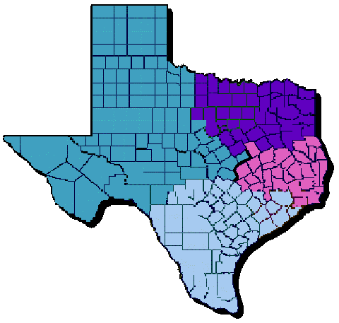
INSTITUTIONAL PAROLE OFFICES
REGIONAL HEADQUARTERS
Northern IPO Region
Palestine
Western IPO Region
Gatesville
Central IPO Region
Huntsville
Southern IPO Region
Angleton

Slide 11
INSTITUTIONAL PAROLE
There are 206 Institutional Parole Officers (IPOs) assigned to 4 regions, covering 119 prison units and 254 counties.
Texas Board of Pardons and Paroles
PACT Conference
11 of 42

Slide 12
PAROLE REVIEW PROCESS
If approved, release processing continues by developing a release plan and verifying completion of any required rehabilitative programming before physical release. The offender may be released on or after the parole eligibility date or date specified by the BPP.
If denied parole, offender is considered for parole in four months from the next scheduled review date, which is set by the Parole Board.
Following offender conviction, county commitment documents are forwarded to the Institutional Division for placement in TDCJ data systems.
Offender is identified as eligible for parole within six months of calculated parole eligibility (or set review date based on prior Parole Board action).
Parole Officer gathers pertinent data regarding offender (from offense reports, probation reports, parole revocation information, etc.).
Using Case Summary and related documents, Parole Board makes decision and sets appropriate special conditions.
Parole Officer interviews offender and completes detailed Case Summary outlining criminal, social, medical, psychological, and Institutional adjustment history; offender’s file is submitted to Parole Board for review.

Slide 13
IPO FUNCTIONS
Interview offenders and compile comprehensive parole case summaries.
Identify victim information for referral to TDCJ-Victim
Services.
Complete sex offender risk assessments (STATIC 99).
Screen offenders for treatment program eligibility.
Respond to inquiries from offender families, general public,
victims, and law enforcement agencies.
Release offenders from TDCJ facilities, contract facilities and
jails.
Deliver Status Letters to offenders.
Texas Board of Pardons and Paroles
PACT Conference
13 of 42

Slide 14
INSTITUTIONAL PAROLE
CASE SUMMARY
A comprehensive document that details information regarding an offender’s:
Demographics
Commitment Information
Offense details
Criminal History
Substance Abuse History
Physical/Mental Health Status
Social History
Employment History
Current Institutional Adjustment
Release Plans
Texas Board of Pardons and Paroles
PACT Conference
14 of 42

Slide 15
CASE SUMMARY PRODUCTION
FY11 Production:
Initials: 41,468
Subsequents: 36,170
Parole-In-Absentia (PIA): 2,353
Total: 79,991
Texas Board of Pardons and Paroles
PACT Conference
15 of 42

Slide 16
Janice Willett
Director of Institutional Parole Operations
janice.willett@tdcj.state.tx.us
(936) 437-2273
Texas Board of Pardons and Paroles
PACT Conference
Texas Board of Pardons and Paroles
PACT Conference
Texas Board of Pardons and Paroles
PACT Conference
16 of 42
16 of 42

Slide 17
HEARING OPERATIONS
Texas Board of Pardons and Paroles
PACT Conference
17 of 42
Notes:
17

Slide 18
ROLE OF HEARING OPERATIONS
Schedule Hearings
Review and act on attorney determination requests, including appointment of attorneys
Conduct preliminary and revocation hearings
Reviewing and Process hearing reports and waiver packets
Make recommendations for case disposition
Convene hearings for out-of-state cases being supervised in Texas
Provide process for reconsideration of a revocation decision
Texas Board of Pardons and Paroles
PACT Conference
18 of 42
Notes:
18

Slide 19
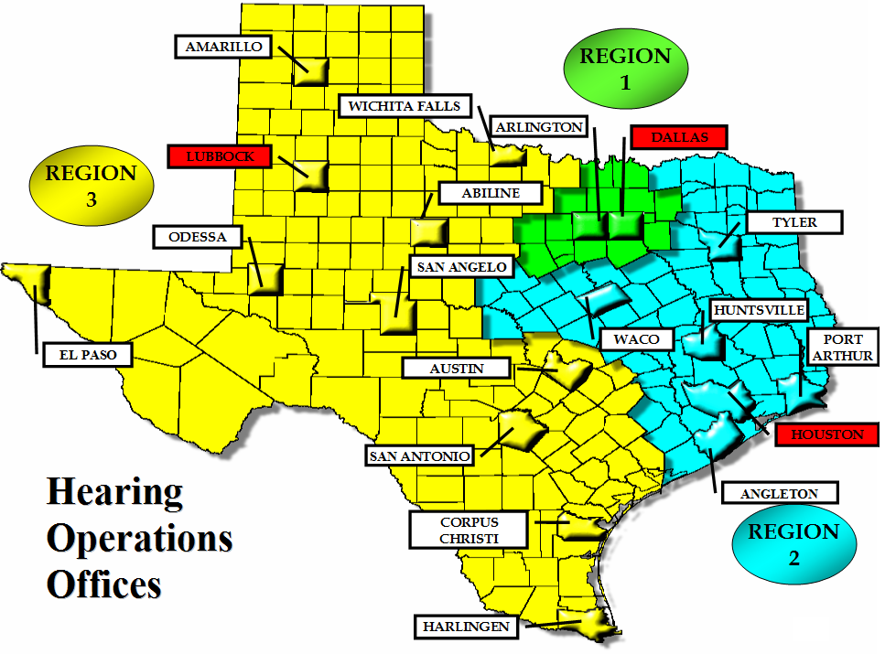

Slide 20
Under the 14th Amendment, Morrissey v. Brewer, 92 S.Ct. 2593 (1972) and Gagnon v. Scarpelli, 93 S.Ct. 1756 (1973) a parolee facing revocation is entitled to:
The releasee also has a limited right to counsel. Whether a releasee is entitled to counsel in every instance, is decided upon a case-by-case basis. Factors considered when determining whether a releasee is entitled to state appointed counsel include whether the releasee is indigent, whether the releasee lacks the ability to articulate or present a defense or mitigation evidence in response to the allegations; and the complexity of the case.
Written notice of the alleged violation(s).
A preliminary hearing to establish whether there is probable cause that the parolee violated the conditions of his parole.
Disclosure of the evidence against the parolee.
The opportunity to be heard, including the opportunity to present witnesses and documentary evidence.
The opportunity to confront and cross-examine witnesses (unless there is a specific finding of good cause to deny such confrontation).
A neutral and detached body to hear the evidence.
A written statement by the fact finders as to the evidence relied upon for any revocation decision.
Notes:
20

Slide 21
PRELIMINARY HEARING
Held at or near the place of the alleged offense
Purpose is to determine whether there is probable cause to believe a condition of release has been violated
Releasee may waive the hearing
Texas Board of Pardons and Paroles
PACT Conference
21 of 42
Notes:
21

Slide 22
REVOCATION HEARING
Purpose is to determine whether there is a preponderance of the credible evidence to believe a condition of release has been violated
Releasee may waive the hearing
Texas Board of Pardons and Paroles
PACT Conference
22 of 42
Notes:
22

Slide 23
POSSIBLE HEARING OUTCOMES
Continue supervision – reaffirm or modify existing Special Conditions
Intermediate Sanction Facility (ISF) / Substance Abuse Felony Punishment (SAFP)
Revoke
Texas Board of Pardons and Paroles
PACT Conference
23 of 42
Notes:
23

Slide 24
MOTION TO REOPEN HEARING
60 days from Board decision to submit a motion to reopen
Circumstances for granting a request:
substantial error in the revocation process
newly discovered information
The Board may
grant motion and re-order reopening
deny motion
Reverse the previous revocation decision
Texas Board of Pardons and Paroles
PACT Conference
24 of 42
Notes:
24

Slide 25
Michael Billings
Director of Hearing Operations
michael.billings@tdcj.state.tx.us
(512) 406-5452
Texas Board of Pardons and Paroles
PACT Conference
25 of 42

Slide 26
MISSION STATEMENT
THE MISSION OF
THE TEXAS BOARD OF PARDONS AND PAROLES is to perform its duties as imposed by Article IV, Section 11, of the Texas Constitution and:
Determine which prisoners are to be released on parole or discretionary mandatory supervision;
Determine conditions of parole and mandatory supervision;
Determine revocation of parole and mandatory supervision; and
Recommend the resolution of clemency matters to the Governor.
Texas Board of Pardons and Paroles
PACT Conference
26 of 42

Slide 27
7 Board Members, 12 Parole Commissioners,
and 6 Board Offices
Texas Board of Pardons and Paroles
PACT Conference
27 of 42

Slide 28
PAROLE PANELS
Members act in panels composed of three persons in matters of release on parole, release to mandatory supervision, revocation actions, and determining conditions of supervision. A majority vote (two consenting votes) determines the outcome. An exception to the three-member panel is cases requiring a vote by board members only (i.e., SB 45 cases or extraordinary votes).
Texas Board of Pardons and Paroles
PACT Conference
28 of 42

Slide 29
TYPES OF RELEASE
Parole is the discretionary release of offenders by a parole panel’s decision.
Mandatory Supervision (MS) is an automatic release when time served plus good time earned equals the sentence length with no requirement for release approval from the Board of Pardons and Parole (BPP). MS was abolished in August 1996 and replaced with Discretionary Mandatory Supervision (DMS); however, there are some offenders who entered prison prior to that time who are still eligible for MS release.
Discretionary Mandatory Supervision (DMS) is for non-violent offenders who offenses were committed on or after 9/1/96 and are eligible for mandatory supervision once actual time served and good time equals their length of sentence.
Discretionary release of inmates from prison by parole panel decision.
The percentage of a sentence that must be served for eligibility varies according to nature of offense, legislature, offense date.
Parole is a privilege, not a right; the Board is never obligated to grant parole.
Texas Board of Pardons and Paroles
PACT Conference
29 of 42

Slide 30
PAROLE REVIEW PROCESS
A case-pull list identifies offenders 6 months prior to initial parole eligibility date and subsequent parole review cases are identified 4 months prior to next review date.
Notice is sent to trial officials/victims/victims’ family.
IPO interviews offender - prepares parole case summary.
Offender’s file is sent to affected board office.
A panel consists of 3 parole panel members
1st voting member reviews/votes case
Case transferred to 2nd voting member - reviews/votes case
2 similar votes = final vote on case
If the first two votes differ from each other, the 3rd voting member of the panel reviews the case and breaks the tie
There must be a majority of two votes for a vote to become final
Offender is notified of parole panel decision via correspondence.
Interviewing the offender is at the discretion of the parole panel member.
Granting interviews to individuals in support/ protest of an offender’s release is also at the parole panel member’s discretion.
Parole panel members must grant interview to victim upon request.
Texas Board of Pardons and Paroles
PACT Conference
30 of 42

Slide 31
FACTORS
CONSIDERED WHEN VOTING:
Seriousness of offense/nature of offense
Criminal history
Length of time served/sentence length
Adjustment during previous period of supervision
Number of incarcerations/Institutional adjustment
Alcohol and/or drug involvement
Letters of support and/or protest
Other arrests
Age
Texas Board of Pardons and Paroles
PACT Conference
31 of 42

Slide 32
VOTING OPTIONS
Parole panel members do not just vote “yes” or “no.”
They have a wide range of voting options:
FI-1: Release when eligible
FI-2: On a specified month/year
FI-3R: Transfer to a TDCJ rehabilitation program, then release to parole only after program completion and no earlier than 3 months from a specified date
FI-4: Transfer to a pre-parole transfer facility and release to parole on a specified date
FI-4R Transfer to a TDCJ rehabilitation program. Release to parole only after program completion and not earlier than four months from specified date. Such TDCJ program shall be the Sex Offender Education Program (SOEP)
FI-5: Release upon completion of the In-Prison Therapeutic Community Substance Abuse Prevention Program
FI-6 Transfer to a DWI Program. Release to continuum of care program as required
FI-6R: Transfer to a TDCJ rehabilitation program, then release to parole only after program completion and no earlier than 6 months from a specified date
FI-7R: Transfer to the Serious and Violent Offender Reentry Initiative (SVORI) program, then release to parole only after program completion and no earlier than 7 months from a specified date
FI-9R: Transfer to a TDCJ rehabilitation program. Release to parole only after program completion and not earlier than nine months from specified date. Such TDCJ program shall be the Sex Offender Treatment Program (SOTP)
FI-18R: Transfer to a TDCJ rehabilitation program, then release to parole only after program completion and no earlier than 18 months from a specified date
NR: Do not release, but set the next parole review month/year
SA: Require the offender to serve all his sentence
Texas Board of Pardons and Paroles
PACT Conference
32 of 42

Slide 33
PAROLE CONSIDERATIONS
FY 2012 YTD
Texas Board of Pardons and Paroles
PACT Conference
33 of 42

Slide 34
PAROLE CONSIDERATIONS
FY 1999 - FY 2011
Texas Board of Pardons and Paroles
PACT Conference
34 of 42

Slide 35
DISCRETIONARY MANDATORY CONSIDERATIONS
FY 2012 YTD
Texas Board of Pardons and Paroles
PACT Conference
35 of 42

Slide 36
DISCRETIONARY MANDATORY CONSIDERATIONS
FY 2000 - FY 2011
Texas Board of Pardons and Paroles
PACT Conference
36 of 42

Slide 37
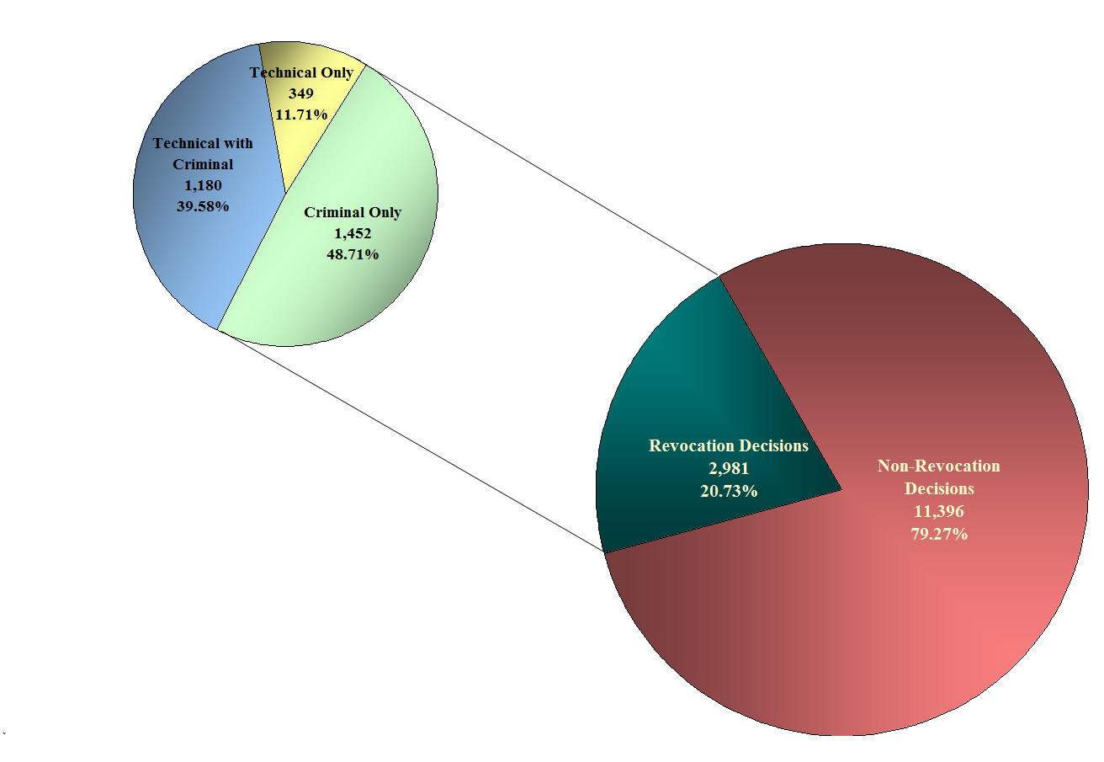
CUMULATIVE DECISIONS WITH REVOCATION TYPE
FY 2012 YTD thru FEBRUARY
Texas Board of Pardons and Paroles
PACT Conference
37 of 42

Slide 38
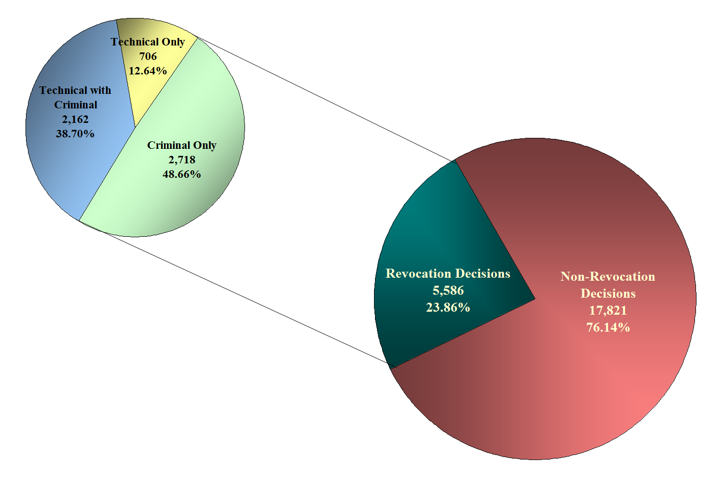
CUMULATIVE DECISIONS WITH REVOCATION TYPE
FY 2011
Texas Board of Pardons and Paroles
PACT Conference
38 of 42

Slide 39
EXECUTIVE CLEMENCY ACTIVITY
FY 2012 thru FEBRUARY
Texas Board of Pardons and Paroles
PACT Conference
39 of 42

Slide 40
EXECUTIVE CLEMENCY ACTIVITY
FY 2011
Texas Board of Pardons and Paroles
PACT Conference
40 of 42

Slide 41
Amarillo Board Office 5809 S. Western, Ste. 237 Amarillo, TX 79110 806-359-7656 James LaFavers Board Member Marsha S. Moberley Parole Commissioner Charles A. Shipman Parole Commissioner | Angleton Board Office 1212 N. Velasco, Ste. 201 Angleton, TX 77515 979-849-3031 Conrith Davis Board Member Lynn Ruzicka Parole Commissioner Federico Rangel Parole Commissioner | Gatesville Board Office 3408 S. State Hwy. 36 Gatesville, TX 76528 254-865-8870 David G. Gutierrez Board Member Elvis Hightower Parole Commissioner Trenton Marshall Parole Commissioner
Huntsville Board Office 1300 11th St., Ste. 520 Huntsville, TX 77342 936-291-2161 Thomas Leeper Board Member Roy (Tony) Garcia Parole Commissioner Pamela Freeman Parole Commissioner | Palestine Board Office 133 E. Reagan Street Palestine, TX 75801 903-723-1068 Michelle Skyrme Board Member Troy Fox Parole Commissioner James Hensarling Parole Commissioner | San Antonio Board Office 2902 N. E. Loop 410, Ste. 206 San Antonio, TX 78218 210-564-3721 Juanita Gonzalez Board Member James Kiel, Jr. Parole Commissioner Charles Speier Parole Commissioner
Texas Board of Pardons and Paroles
PACT Conference
41 of 42

Slide 42
Texas Board of
Pardons and Paroles
P.O. Box 13401, Capitol Station
Austin, TX 78711
Website: http://www.tdcj.state.tx.us/bpp/
Email: bpp-pio@tdcj.state.tx.us

